Slide 1
Program Transformation for Asynchronous Query Submission
Mahendra Chavan*, Ravindra Guravannavar,
Karthik Ramachandra, S Sudarshan
Indian Institute of Technology Bombay,
Indian Institute of Technology Hyderabad
*Current Affiliation: Sybase Inc.

Slide 2
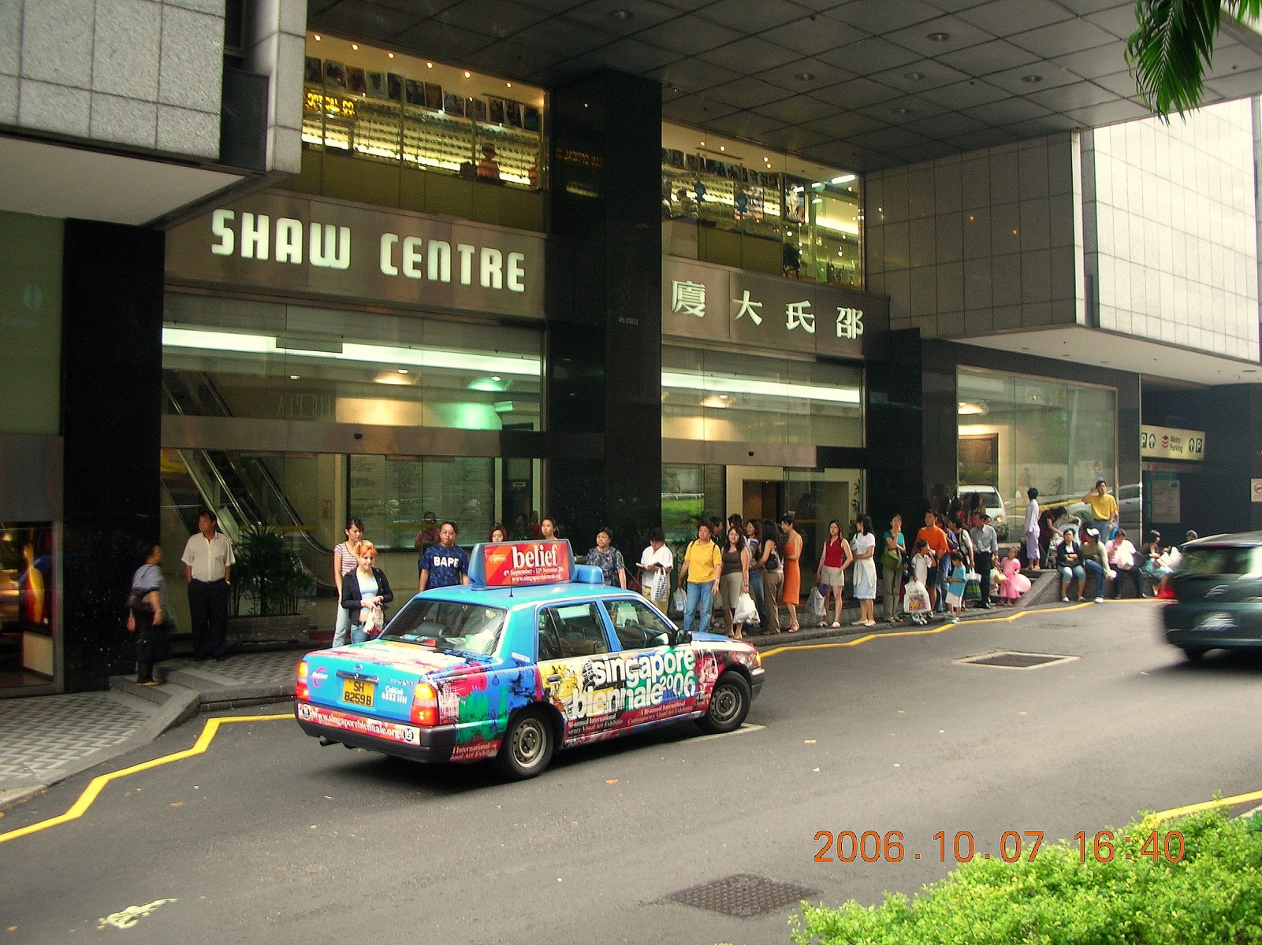
The Problem

Slide 3
The Problem
Applications often invoke Database queries/Web Service requests
repeatedly (with different parameters)
synchronously (blocking on every request)
At the Database end:
Naive iterative execution of such queries is inefficient
No sharing of work (eg. Disk IO)
Network round-trip delays
The problem is not within the database engine!
The problem is the way queries are invoked from the application!!

Slide 4

Solution 1: Use a BUS!

Slide 5
(Our) Earlier Work: Batching
Rewriting Procedures for Batched Bindings
Guravannavar et. al. VLDB 2008
Repeated invocation of a query automatically replaced by a single invocation of its batched form.
Enables use of efficient set-oriented query execution plans
Sharing of work (eg. Disk IO) etc.
Avoids network round-trip delays
Approach
Transform imperative programs using equivalence rules
Rewrite queries using decorrelation, APPLY operator etc.

Slide 6
Program Transformation for Batched Bindings (VLDB08 paper)
qt = con.Prepare(
"SELECT count(partkey) " +
"FROM part " +
"WHERE p_category=?");
while(!categoryList.isEmpty()) {
category = categoryList.next();
qt.bind(1, category);
qt.addBatch();
}
qt.executeBatch();
while(qt.hasMoreResults()) {
count = qt.getNextResult();
sum += count;
}
qt = con.prepare(
"SELECT count(partkey) " +
"FROM part " +
"WHERE p_category=?");
while(!categoryList.isEmpty()) {
category = categoryList.next();
qt.bind(1, category);
count = qt.executeQuery();
sum += count;
}
**
** Conditions apply. See Guravannavar and Sudarshan, VLDB 2008

Slide 7
Limitations of Earlier Work on Batching
Limitations (Opportunities?)
Some data sources e.g. Web Services may not provide a set oriented interface
Arbitrary inter-statement data dependencies may severely limit applicability of transformation rules
Multicore processing power on the client can be exploited better by using multiple threads of execution
Our Approach
Exploit asynchronous query execution, through
New API
Automatic Program rewriting
Improved set of transformation rules
Increase applicability by reordering

Slide 8

Asynchronous Execution: More Taxis!!

Slide 9
Motivation
Fact 1: Performance of applications can be significantly improved by asynchronous submission of queries.
Multiple queries could be issued concurrently
Application can perform other processing while query is executing
Allows the query execution engine to share work across multiple queries
Reduces the impact of network round-trip latency
Fact 2: Manually writing applications to exploit asynchronous query submission is HARD!!

Slide 10
Our Contributions in this paper
Automatically transform a program to exploit Asynchronous Query Submission
A novel Statement Reordering Algorithm that greatly increases the applicability of our transformations
An API that wraps any JDBC driver and performs these optimizations (DBridge)
System design challenges and a detailed experimental study on real world applications

Slide 11
Automatic Program Transformation for asynchronous submission
Increasing the applicability of transformations
System design and experimental evaluation

Slide 12
Program Transformation Example
qt = con.Prepare(
"SELECT count(partkey) " +
"FROM part " +
"WHERE p_category=?");
int handle[SIZE], n = 0;
while(!categoryList.isEmpty()) {
category = categoryList.next();
qt.bind(1, category);
handle[n++] = submitQuery(qt);
}
for(int i = 0; i < n; i++) {
count = fetchResult(handle[i]);
sum += count;
}
qt = con.prepare(
"SELECT count(partkey) " +
"FROM part " +
"WHERE p_category=?");
while(!categoryList.isEmpty()) {
category = categoryList.next();
qt.bind(1, category);
count = executeQuery(qt);
sum += count;
}
Conceptual API for asynchronous execution
executeQuery() – blocking call
submitQuery() – initiates query and returns immediately
fetchResult() – blocking wait

Slide 13
Asynchronous query submission model
Thread
qt = con.prepare(
"SELECT count(partkey) " +
"FROM part " +
"WHERE p_category=?");
int handle[SIZE], n = 0;
while(!categoryList.isEmpty()) {
category = categoryList.next();
qt.bind(1, category);
handle[n++] = submitQuery(qt);
}
for(int i = 0; i < n; i++) {
count = fetchResult(handle[i]);
sum += count;
}
Submit Q
DB
Result array
submitQuery() – returns immediately
fetchResult() – blocking call

Slide 14
Program Transformation
Possible to rewrite manually, but tedious.
Challenge:
Complex programs with arbitrary control flow
Arbitrary inter-statement data dependencies
Loop splitting requires variable values to be stored and restored
Our contribution 1: Automatically rewrite to enable asynchrony.
int handle[SIZE], n = 0;
while(!categoryList.isEmpty()) {
category = categoryList.next();
qt.bind(1, category);
handle[n++] = submitQuery(qt);
}
for(int i = 0; i < n; i++) {
count = fetchResult(handle[i]);
sum += count;
}
while(!categoryList.isEmpty()) {
category = categoryList.next();
qt.bind(1, category);
count = executeQuery(qt);
sum += count;
}
Notes:
Remove image, expand why it is tedious

Slide 15
Program transformation rules
Rule A: Equivalence rule for Loop fission
Minimal pre-conditions
Simplified handling of nested loops
Rule B: Converting control dependencies to flow dependencies
Enables handling conditional branching(if-then-else) structures
Rule C1, C2, C3: Rules to facilitate reordering of statements
Used by our statement reordering algorithm (coming up next)
All the above simplify and generalize the transformation rules of our VLDB08 paper
For details, refer to our paper

Slide 16
Increasing the applicability of transformations
Automatic Program Transformation for asynchronous submission
System design and experimental evaluation

Slide 17

Applicability of transformations
Pre-conditions due to inter statement dependencies restrict applicability
Our Contribution 2: A Statement Reordering algorithm that
Removes dependencies that prevent transformation
Enables loop fission at the boundaries of the query execution statement
while (category != null) {
qt.bind(1, category);
int count = executeQuery(qt);
sum = sum + count;
category = getParent(category);
}
while (category != null) {
int temp = category;
category = getParent(category);
qt.bind(1, temp);
int count = executeQuery(qt);
sum = sum + count;
}
Loop fission not possible due to dependency ( )
Loop fission enabled by safe reordering

Slide 18
Before
Data Dependence Graph (DDG)
S1
S1:
while (category != null) {
qt.bind(1, category);
int count = executeQuery(qt);
sum = sum + count;
category = getParent(category);
}
S2:
S3:
S2
S4:
S3
S4
Flow Dependence (W-R)
Anti Dependence (R-W)
Output Dependence (W-W)
Control Dependence
Loop-Carried
Notes:
Balloon for lcfd – problematic edge

Slide 19
Before
S1:
while (category != null) {
qt.bind(1, category);
int count = executeQuery(qt);
sum = sum + count;
category = getParent(category);
}
S2:
S3:
S4:
Intuition: Move S4 before S2
After
S1:
while (category != null) {
int temp = category;
category = getParent(category);
qt.bind(1, temp);
int count = executeQuery(qt);
sum = sum + count;
}
S5:
S4:
S2:
S3:

Slide 20
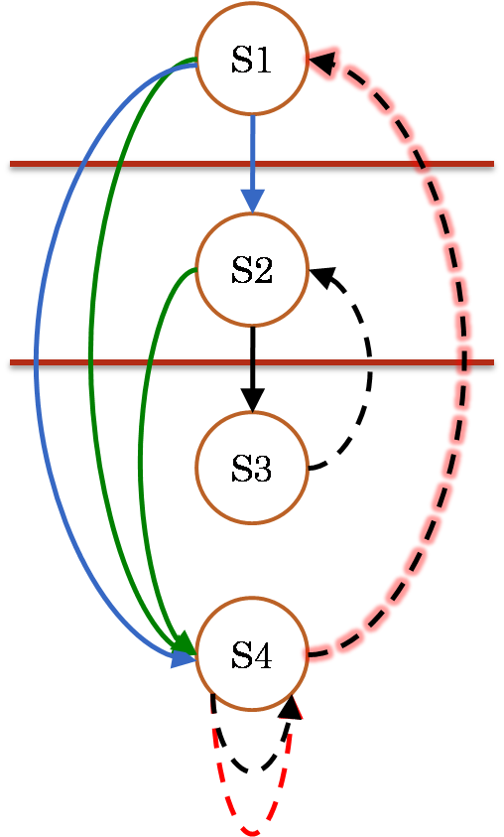
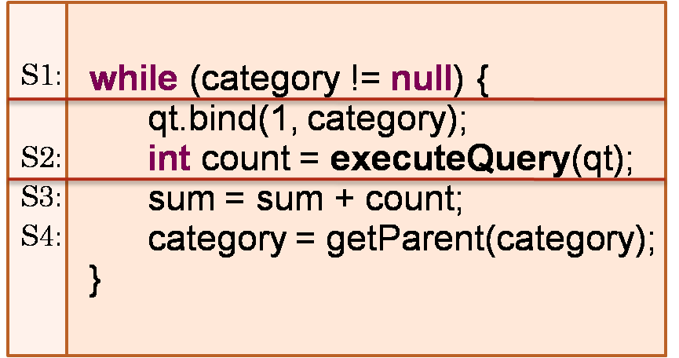
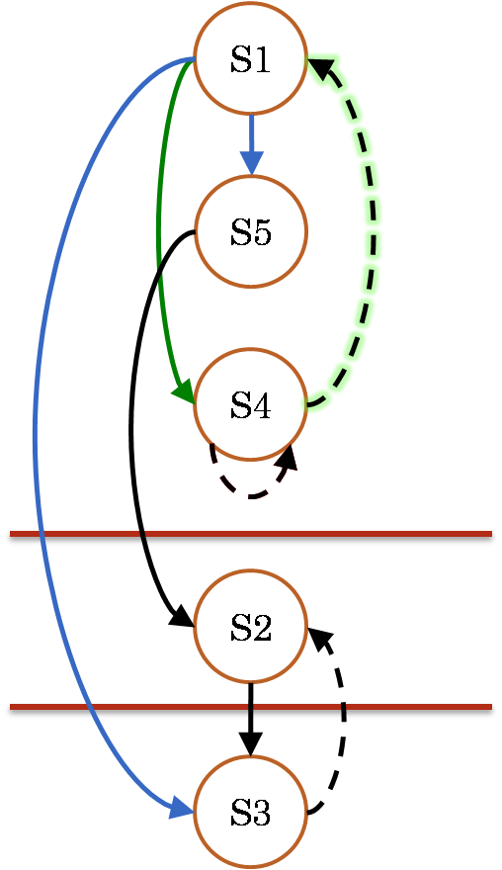
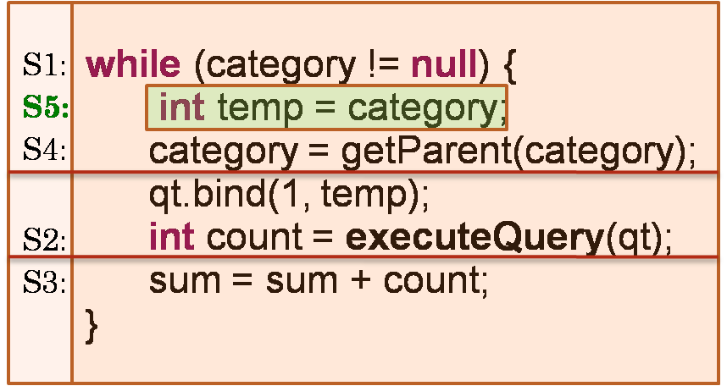
Before
After

Slide 21
The Statement Reordering Algorithm
Goal: Reorder statements such that no loop-carried flow dependencies cross the desired split boundary.
Input:
The blocking query execution statement Sq
The basic block b representing the loop
Output: Where possible, a reordering of b such that:
No LCFD edges cross the split boundary Sq
Program equivalence is preserved

Slide 22
The Statement Reordering Algorithm*
For every loop carried dependency that crosses the query execution statement
Step 1: Identify which statement to move(stm) past which one (target)
Step 2: Compute statements dependent on the stm (stmdeps)
Step 3: Move each of stmdeps past target
Step 4: Move stm past target
*heavily simplified; refer to paper for details

Slide 23
The Statement Reordering Algorithm
Definition: A True-dependence cycle in a DDG is a directed cycle made up of only FD and LFD edges.
Theorem:
If a query execution statement doesn’t lie on a true-dependence cycle in the DDG, then algorithm reorder always reorders the statements such that the loop can be split.
Proof in [Guravannavar 09]
Theorem and Algorithm applicable for both Batching and Asynchronous submission transformations
Notes:
Applicability without reordering –
Applicability: 75-100% of loops on 2 benchmarks after reordering

Slide 24
System design and Experimental evaluation
Automatic Program Transformation for asynchronous submission
Increasing the applicability of transformations

Slide 25
System Design: DBridge
For Java applications using JDBC
SOOT framework for analysis and transformation

Slide 26
DBridge API
Java API that extends the JDBC interface, and can wrap any JDBC driver
Can be used with:
Manual rewriting (LoopContext structure helps deal with loop local variables)
Automat ic rewriting
Hides details of thread scheduling and management
Same API for both batching and asynchronous submission
DBridge: A Program Rewrite tool for Set-oriented Query Execution
Demonstrations Track 1, ICDE 2011

Slide 27
Experiments
Conducted on 5 applications
Two public benchmark applications (Java/JDBC)
Two real world applications (Java/JDBC)
Freebase web service client (Java/JSON)
Environments
A widely used commercial database system – SYS1
64 bit dual-core machine with 4 GB of RAM
PostgreSQL
Dual Xeon 3 GHz processors and 4 GB of RAM

Slide 28
Experiment scenarios
Impact of iteration count
Impact of number of threads
Impact of Warm cache vs. Cold cache
Since Disk IO on the database is an important parameter

Slide 29
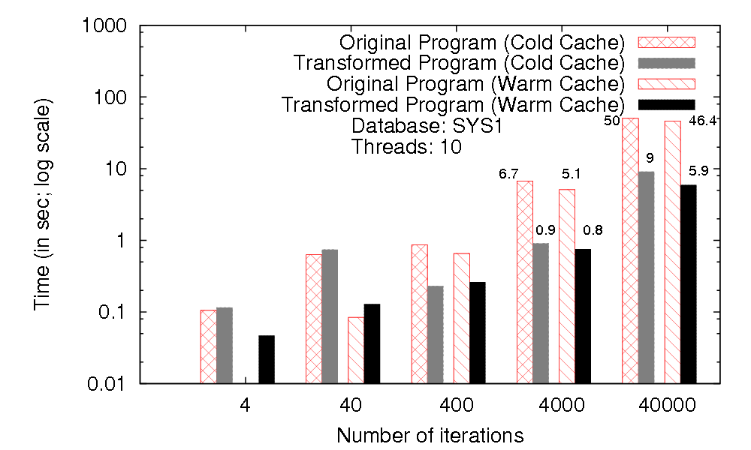
Auction Application: Impact of Iteration count, with 10 threads
Time
In seconds
Log Scale!
For small no. (4-40) iterations, transformed program slower
At 400-40000 iterations, factor of 4-8 improvement
Similar for warm and cold cache
Notes:
Highlight log scale and factor of 8

Slide 30
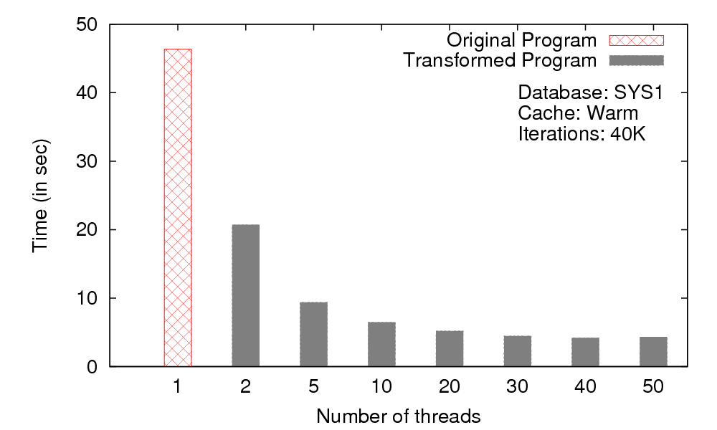
Auction Application: Impact of thread count, with 40K iterations
Time taken reduces drastically as thread count increases
No improvement after some point (30 in this example)

Slide 31
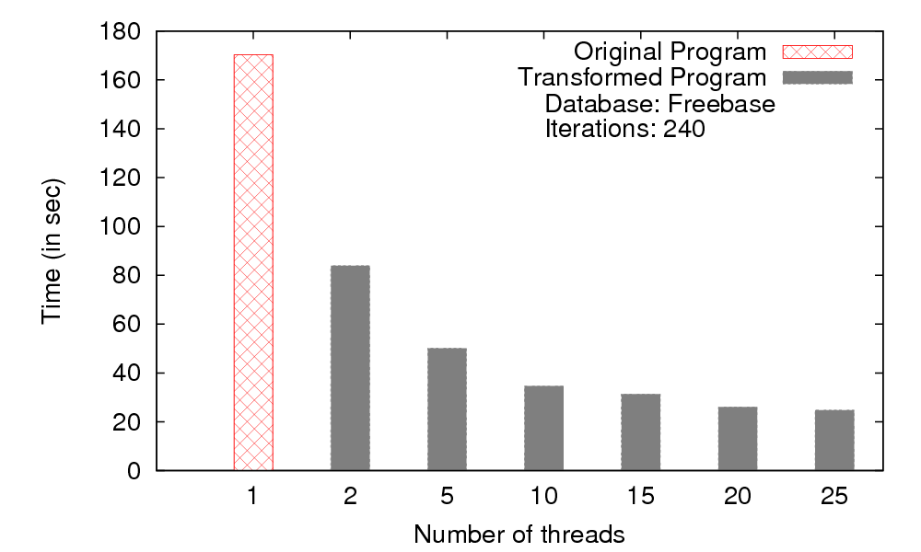
WebService: Impact of thread count
HTTP requests with JSON content
Impact similar to earlier SQL example
Note: Our system does not automatically rewrite web service programs, this example manually rewritten using our transformation rules
Notes:
Slide on batch vs async

Slide 32
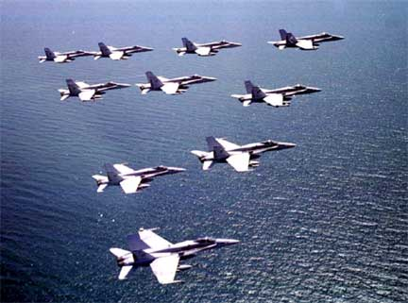
Future Directions?
Which calls to be transformed?
Minimizing memory overheads
How many threads to use?
Updates and transactions
Acknowledgements
MSR India – travel support
Prabhas Samanta (IIT Bombay) – DBridge API implementation

Slide 33
After
Data Dependence Graph (DDG)
S1
S1:
while (category != null) {
int temp = category;
category = getParent(category);
qt.bind(1, temp);
int count = executeQuery(qt);
sum = sum + count;
}
S5:
S4:
S5
S2:
S3:
S4
Intuition: S2 moved past S4
S2
Flow Dependence (W-R)
Anti Dependence (R-W)
Output Dependence (W-W)
S3
Control Dependence
Loop-Carried
Notes:
Show before and after together

